Slide 1
Lecture 01-02
Data Structures
Code: CS2001
Introduction & revision of basic concepts
Samin Ahmed
FAST-NUCES
Peshawar Campus

Slide 2
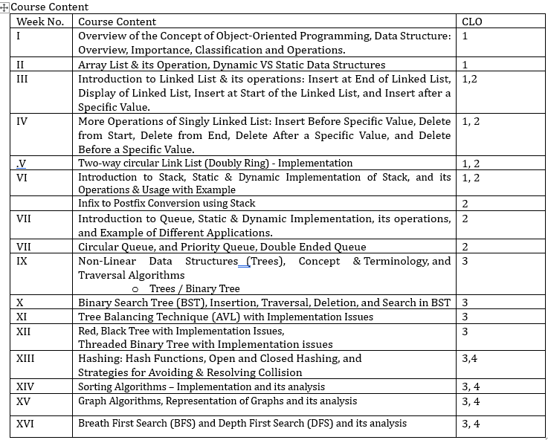
Overview
Formative Assessment | 20%
Quizzes | 10%
Assignments | 5% or 10%
Presentations/Project | 5% or 0%
Summative Assessment | 80%
Sessional I | 15%
Sessional II | 15%
Final Exams | 50%
Introduction
Objective of the Course
Course Outlines
Marks Distribution
Attendance, Assessments, Assignments, Quizzes, Sessionals, Final Exam
100% Attendance is necessary, only 20% Attendance may be condoned by the HoD in exigent cases.
Text Books:
Data Structures Using C++ By DS Malik
Reference Books:
Fundamental of Data Structure in C++ Elli Horowith, Sarta Sahn, and Dines Meht.

Slide 3
Data Structure
Organizing data or giving shape / structure to data.
To write efficient algorithms / programs
Efficient ? :
Time: faster algorithms / programs
Space: Use Less memory space

Slide 4
Categories
Data Structures
Linear
Non Linear

Slide 5
Linear
Categories
Data Structures
Non Linear

Slide 6
Linear Data Structures
Linear
Array
Linked List
Stack
Queue

Slide 7
Data stored in sequence
Array
Linear Data Structures
Easy implementation
Single Layer
Linear
Queue
Linked List
All data can be accessed/traversed in one go.
Run-Time increases with data size
Stack
Inefficient memory utilization

Slide 8
Categories
Data Structures
Linear
Non Linear

Slide 9
Linear
Categories
Data Structures
Non Linear

Slide 10
Non Linear Data Structures
Non Linear
Graphs
Trees

Slide 11
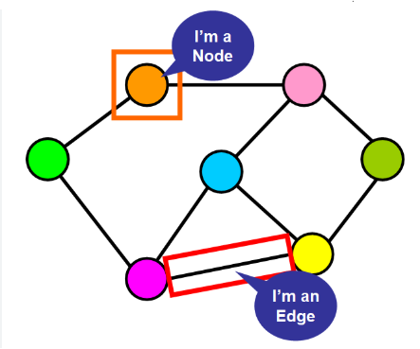
Non-Sequential / Hierarchical storage
Non Linear Data Structures
difficult implementation
Non Linear
Multiple Layers
Graphs
Trees
All data cannot be accessed/traversed in one go.
Run-Time remains same with increase in data size
Efficient memory utilization

Slide 12

MULTI-DIMENSIONAL ARRAY

Slide 13
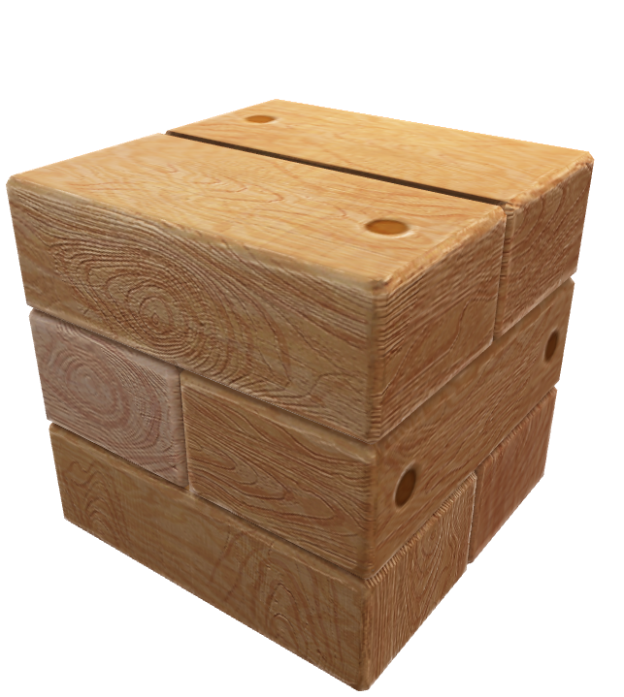
Multidimensional Array is simply an array of arrays.
Multidimensional Arrays
Where each dimension is mapped to a concept.
Data is mapped to the last dimension.
Total number of locations in a multidimensional array is the product of number of locations in each dimension.
Total number of locations = D1 x D2 x D3 …….x Dn
Where:
D1 = size or locations in first dimension
D2 = size or locations of second dimension
…………….
…………….
……………..
Dn = size or locations of nth (last) dimension

Slide 14
Declaration & Mapping concepts(D&MC)
Data type
Array Name
[
size1
]
[
size2
];
int
twoD
[
4
]
[
3
];
Rows
columns
2-Dimensions
Map the outer dimension to rows (i.e. 4 rows).
Map the inner dimension to columns (i.e. 3 columns).
0
1
2
twoD
Size(locations)
= rows x Columns
= 4 x 3
= 12
0
[
0
]
[
0
]
[
0
]
[
1
]
[
0
]
[
2
]
1
[
1
]
[
0
]
[
1
]
[
1
]
[
1
]
[
2
]
2
[
2
]
[
0
]
[
2
]
[
1
]
[
2
]
[
2
]
3
[
3
]
[
0
]
[
3
]
[
1
]
[
3
]
[
2
]

Slide 15
Memory Layouts
Row-Major order
Elements of each row of the array are stored in contiguous memory locations.
Examples include C/C++, Java, Python.
Column-Major order
Elements of each column of the array are stored in contiguous memory locations.
Examples include Fortran, MATLAB, R.
Important to know about memory layout for efficient programming.

Slide 16

int
TwoD
[
4
]
[
3
];
Row-Major Order
0
1
2
TwoD
0
1
2
3
1
4
5
6
2
7
8
9
3
10
11
12
[
int value=1 ;
Store the given matrix in row-major order
]
1 2 3
4 5 6
7 8 9
10 11 12
for
(
int i=0;
i < 4;
i++
)
for
(
int j=0;
j < 3;
j++
)
TwoD[i][j] = value++;

Slide 17
int
TwoD
[
4
]
[
3
];
Column-Major Order
0
1
2
TwoD
0
1
2
3
1
4
5
6
2
7
8
9
3
10
11
12
[
]
print the given matrix in column-major order
1 2 3
4 5 6
7 8 9
10 11 12
for
(
int j=0;
j < 3;
j++
)
for
(
int i=0;
i < 4;
i++
)
cout<<TwoD[i][j];
Similar to taking transpose of a matrix.

Slide 18
(D&MC)
Data type
Array Name
[
size1
]
[
size2
]
[
size3
];
int
threeD
[
4
]
[
3
]
[
2
];
3-Dimensions
Rows
Size(locations)
= 4 x 3 x 2 = 24
Tables
Columns
Each threeD [ T ] contains 3 x 2 locations.
0
1
0
1
0
0
[
0
]
[
0
]
[
0
]
[
0
]
[
0
]
[
1
]
1
0
[
1
]
[
0
]
[
1
]
threeD
[
0
]
[
0
]
[
1
]
1
[
0
]
[
1
]
[
0
]
[
0
]
[
1
]
[
1
]
1
[
1
]
[
1
]
[
0
]
[
1
]
[
1
]
[
1
]
2
[
0
]
[
2
]
[
0
]
[
0
]
[
2
]
[
1
]
2
[
1
]
[
1
]
[
2
]
[
0
]
[
2
]
[
1
]
0
1
0
1
2
0
[
2
]
[
0
]
[
0
]
[
2
]
[
0
]
[
1
]
3
0
[
3
]
[
0
]
[
0
]
[
3
]
[
0
]
[
1
]
1
[
2
]
[
1
]
[
0
]
[
2
]
[
1
]
[
1
]
1
[
3
]
[
1
]
[
0
]
[
3
]
[
1
]
[
1
]
2
[
2
]
[
2
]
[
0
]
[
2
]
[
2
]
[
1
]
2
[
3
]
[
2
]
[
0
]
[
3
]
[
2
]
[
1
]

Slide 19

Mapping Dimensions & Calculating Sizes (Locations)
Data type
Array Name
[
size1
]
[
size2
]
[
size3
]
[
size4
]
[
size5
];
Books
Pages
Tables
Rows
Columns
int
MD
[
5
]
[
3
]
[
4
]
[
3
]
[
2
];
Use your imagination to extend this concept incase of more dimensions such as bag, shelf, library etc etc.
Complete size of single dimension?
MD[ ]= 5 X 72 =360
MD[ ][ ]=3 X 24 = 72
MD[ ][ ][ ]=4X 6 = 24
MD[ ][ ][ ][ ]=3X2= 6
Finding total size of array and single element in each dimension in terms of locations
Element: will refer to location containing sub-array.
Element 0
Element 0
Element 0
Element 0
Total size = size1 x size2 x size3 x size4 x size5
Element 1
Element 1
Element 1
Element 1
Total size of MD = 5 x 3 x 4 x 3 x 2 = 360 Locs.
Element 2
Element 2
Element 2
Element 2
size of MD [0] = 3 x 4 x 3 x 2 = 72 Locs.
Single element of First (books) dimension
Element 3
Element 3
Element 4
Data Element: will refer to location of last index mapped to data.
Single element of Second(Pages)dimension
size of MD [0][0] = 4 x 3 x 2 = 24 Locs.
Single element of Third (Tables) dimension
size of MD [0][0][0] = 3 x 2 = 6 Locs.
Single element of Fourth (Rows) dimension
size of MD [0][0][0][0] = 2 Locs.

Slide 20
Size of the first dimension is equal to the size of the entire array
.
Size of a dimension can also be determined by determining size of a single element in the previous dimension.
Complete size of a Dimension (Locations) =
#of elements in dimension * #of locations in single element of subarray
Dimension Size (Locations)
Key Points

Slide 21
Array Size (Bytes) = size of single data element * # of locations
Calculating MD-Array Size
int n[6][2][2];
Array Size = 4 * 24
Array Size = 96 bytes
int Size_n_bytes =
sizeof(n) ;
C++ calculates size of the entire array in bytes using above formula
Code for array size in bytes?
int Size_n_Locs =
sizeof (n)
/
sizeof (n[0][0][0]) ;
Code for array size in number of locations / index ?
calculates total number of locations / indices present in array.
int size_array = sizeof (array) / sizeof (single data element)

Slide 22
Dimension Size (Bytes)
= #of elements in dimension * #of locations in single element of subarray* sizeOf data type
Calculating Dimension Size
int n[6][2][2];
First dimension Size n1[ ]= 6 * 4 *4
= 96 bytes
Code for dimension size in bytes?
= 16 bytes
Second dimension Size n2[ ][ ]= 2 * 2 *4
Sizeof operator when applied to an element of dimension, it looks for number of locations in the sub-array
Third dimension Size n3[ ][ ][ ]= 2 * 1 *4
= 8 bytes
int Size_n1_bytes =
6 * sizeof( n[0] );
int Size_n1_bytes =
sizeof( n ) ; //size of entire array is same as first dimension
int Size_n2_bytes =
2 * sizeof( n[0][0] );
int Size_n3_bytes =
2 * sizeof( n[0][0][0] );
C++ calculates size of dimension in bytes using black part of the formula

Slide 23

Dimension Size (Bytes)
=#of elements in dimension * #of locations in single element of subarray* sizeOf data type
Calculating Dimension Size
#of elements in dimension
= Dimension Size (Bytes)
#of locations in single element of subarray * size of data type
How to calculate the sizes using code?
Apply sizeof to a single element of the previous dimension
Apply sizeof to a single element of the current dimension
#of elements in dimension
= Size of single element in previous dimension
#of locations in single element of subarray * size of data type

Slide 24
#of elements in dimension =
Size of single element in previous dimension
#of locations in single element of subarray * size of data type
int
n
[
5
]
[
3
]
[
4
]
[
3
]
[
2
];
int Size_n1Locs =
sizeof (n)
/
sizeof (n[0]) ;
int Size_n2Locs =
sizeof (n[0])
/
sizeof (n[0][0]) ;
int Size_n3Locs =
sizeof (n[0][0])
/
sizeof (n[0][0][0]) ;
int Size_n4Locs =
sizeof (n[0][0][0])
/
sizeof (n[0][0][0][0]) ;
int Size_n5Locs =
sizeof (n[0][0][0][0])
/
sizeof (n[0][0][0][0][0]) ;
#of locations in kth dimension =
sizeof ( first element in k --1 dimension of the array )
sizeof ( first element in kth dimension of the array )

Slide 25
int
n
[
2
]
[
3
]
[
2
]
[
3
] =
MD
Array Initialization
{
{
{
{1,2,3}
{4,5,6}
}
{
{7,8,9}
{10,11,12}
}
{
{13,14,15}
{16,17,18}
}
,
,
,
,
,
}
{
,
{
{19,20,21}
{22,23,24}
}
{
{25,26,27}
{28,29,30}
}
{
{31,32,33}
{34,35,36}
}
,
,
,
,
,
}
}
Full initialization
Start from outermost dimension (leftmost, first dimension)
Replace each bracket with a curly bracket
For a dimension of size k, place k-1 commas inside curly brackets.
Repeat step 2 & 3 before and after every comma until reaching last dimension
After reaching last dimension repeat step 2 & 3 one more time, after that place data in the last dimension (only) before and after every comma.

Slide 26
int
n
[
2
]
[
3
]
[
2
]
[
3
] =
MD
Array Initialization
{
{
{
{1,2}
{4,5}
}
{
{7,8}
{10,11,12}
}
{
{13,14,15}
{16,17,18}
}
,
,
,
,
,
}
,
{
{
{ 19 }
{22}
}
{
{25,26,27}
{28,29,30}
}
{
{ }
{ }
}
,
,
,
,
,
}
}
Partial initialization
All pending values will be initialized to zero (for int data types)
Array will contain the following values.
int n[2][3][2][3] = { 1 , 2, 0, 4, 5, 0, 7, 8, 0, 10, 11, 12, 13, 14, 15, 16, 17, 18, 19, 0, 0, 22, 0, 0, 25, 26, 27, 28, 29, 30, 0, 0, 0 , 0, 0, 0 };

Slide 27
int
n
[
2
]
[
3
]
[
2
]
[
3
] = {0};
MD
Array Initialization
Zero initialization
int n[2][3][2][3] = { 1 , 2, 3, 4, 5, 6, 7, 8, 9, 10, 11, 12, 13, 14, 15, 16, 17, 18, 19, 20, 21, 22, 23, 24, 25, 26, 27, 28, 29, 30, 31, 32, 33, 34, 35, 36 } ;
1D Style initialization
All values will be initialized to zero (for int data types)
A multi dimensional array can be initialized like as One-D array, though this style is not recommended.
As this may cause issues: such as structure of the array is not clear, partial initialization of the array (example given on previous slide) is not possible through this style.

Slide 28
int
MD
[
5
]
[
3
]
[
4
]
[
3
]
[
6
];
int size_MD1=sizeof(MD)/sizeof(MD[0]) ,
size_MD2=sizeof(MD[0])/sizeof(MD[0][0]) ,
size_MD3=sizeof(MD[0][0])/sizeof(MD[0][0][0]) ,
size_MD4=sizeof(MD[0][0][0])/sizeof(MD[0][0][0[0]) ,
size_MD5=sizeof(MD[0][0][0][0])/sizeof(MD[0][0][0[0][0]) ;
for
(
int i=0;
i < size_md1;
i++
)
for
(
int j=0;
j < size_md2;
j++
)
for
(
int k=0;
k < size_md3;
k++
)
for
(
int l=0;
l < size_md4;
l++
)
for
(
int m=0;
m < size_md5;
m++
)
cin>>MD[i][j][k][l][m];
Initializing at runtime through LOOPs
Write a Loop for every dimension.
Outer Loops for outer dimensions.
Inner Loops for inner dimensions.

Slide 29
Problem Statement: Storing Temperature of 5 cities of the entire week for each Hour
Mapping Real-World Problems
const int cities=5 ;
const int days=7 ;
const int hours=24 ;
int
Temperature
[
cities
]
[
days
]
[
hours
];
for
(
int i=0;
i < cities;
i++
)
Mapping Dimensions to Concepts:
[cities]: 0= Peshawar, 1= Karachi, 2=Lahore, 3= Islamabad, 4= Faisalabad (Five campuses of FAST)
[Days]: 0-6 = Sun,Mon,Tue,Wed,Thu,Fri,Sat
[Hours]: 0-23 = 24 hours of day
for
(
int j=0;
j < days;
j++
)
for
(
int k=0;
k < hours;
k++
)
What was the temperature of each hour on Friday in Peshawar?
cin>>Temprature[i][j][k];
for
(
int k=0;
k < hours;
k++
)
Print temperature of Karachi for all seven days?
cout<<Temprature[0][5][k];
for
(
int j=0;
j < days;
j++
)
for
(
int k=0;
k < hours;
k++
)
cout<<Temprature[1][j][k];

Slide 30
Problem Statement: storing data of students for distributing financial aid (scholarship)
Statement: The government financial department needs to decide upon distribution of funds among 180,000 University-Students country-wide, equally divided into four categories. To ensure a fair distribution of amounts in parentages (25%, 50%, 75%, 100%), it was decided in the cabinet meeting to develop a criteria based on data gathered (with emphasis on financial income of each student’s household) to format the data as per details mentioned below:
Students of 22, 23 & 24 batches (years of admission) will be eligible for scholarship.
In each batch students will be divided into four groups based on their Academic performance in grade 12( F.Sc / A-Levels etc. ): 1 ) Excellent (92% to 100%) 2 ) Very Good (80% to 91%) 3 ) Good (70% to 80%) 4 ) Average (60% to 69%).
Students will also be divided into two categories bases on how they are paying their Fee: Self-Earning & Dependent on Family.
Students will be grouped into five slabs based on their household earnings (self or defendant): 1 ) 200,000 to 250,000 2 ) 150,000 to 199,000 3 ) 100,000 to 149,000 4) 50,000 to 99,000 5)15,000 to 45,000

Slide 31
Problem Statement: storing data of students for distributing financial aid (scholarship)
const int batches=3 ;
, academics=4
, earnings=2
, slabs=5
, data=1500 ;
long
Financials
[
batches
]
[
academics
]
[
Earnings
]
[
Slabs
]
[
data
];
Total students = 3 x 4 x 2 x 5 x 1500 = 180,000
Mapping Dimensions to Concepts:
[batches]: 0=22, 1=23, 2=24
[academics]: 0=Excellent, 1=Very Good, 2=Good, 3=Average
[earnings]: 0=Self, 1=Family-Dependant
[slabs]: 0=slab1, 1=slab2, 2=slab3, 3=slab4, 4=slab5
[data]: 0 – 1499: containing Household income of students.
for
(
int i=0;
i < batches;
i++
)
for
(
int j=0;
j < academics;
j++
)
for
(
int k=0;
k < earnings;
k++
)
for
(
int l=0;
l < slabs;
l++
)
for
(
int m=0;
m < data;
m++
)
cin>>Financials[i][j][k][l][m];

Slide 32
Problem Statement: storing data of students for distributing financial aid (scholarship)
const int batches=3 ;
, academics=4
, earnings=2
, slabs=5
, data=1500 ;
long
Financials
[
batches
]
[
academics
]
[
Earnings
]
[
Slabs
]
[
data
];
Mapping Dimensions to Concepts:
[batches]: 0=22, 1=23, 2=24
[academics]: 0=Excellent, 1=Very Good, 2=Good, 3=Average
[earnings]: 0=Self, 1=Family-Dependant
[slabs]: 0=slab1, 1=slab2, 2=slab3, 3=slab4, 4=slab5
[data]: 0 – 1499: containing Household income of students.
Print financial data of all students of batch-22?
for
(
int j=0;
j < academics;
j++
)
for
(
int k=0;
k < earnings;
k++
)
for
(
int l=0;
l < slabs;
l++
)
for
(
int m=0;
m < data;
m++
)
cout<<Financials[0][j][k][l][m];

Slide 33
Problem Statement: storing data of students for distributing financial aid (scholarship)
const int batches=3 ;
, academics=4
, earnings=2
, slabs=5
, data=1500 ;
long
Financials
[
batches
]
[
academics
]
[
Earnings
]
[
Slabs
]
[
data
];
Dimensions Mapping :
[batches]: 0=22, 1=23, 2=24
[academics]: 0=Excellent, 1=Very Good, 2=Good, 3=Average
[earnings]: 0=Self, 1=Family-Dependant
[slabs]: 0=slab1, 1=slab2, 2=slab3, 3=slab4, 4=slab5
[data]: 0 – 1499: containing Household income of students.
Print financial data of all students of batch-23 & 24 having excellent academic performance in grade-12?
for
(
int i=1;
i < batches;
i++
)
for
(
int k=0;
k < earnings;
k++
)
for
(
int l=0;
l < slabs;
l++
)
for
(
int m=0;
m < data;
m++
)
cout<<Financials[i][0][k][l][m];

Slide 34
Problem Statement: storing data of students for distributing financial aid (scholarship)
const int batches=3 ;
, academics=4
, earnings=2
, slabs=5
, data=1500 ;
long
Financials
[
batches
]
[
academics
]
[
Earnings
]
[
Slabs
]
[
data
];
Print the financial data of Batch-24 students who have very good academic performance, are self-funding their tuition fees, and have the lowest monthly income?
Dimensions Mapping :
[batches]: 0=22, 1=23, 2=24
[academics]: 0=Excellent, 1=Very Good, 2=Good, 3=Average
[earnings]: 0=Self, 1=Family-Dependent
[slabs]: 0=slab1, 1=slab2, 2=slab3, 3=slab4, 4=slab5
[data]: 0 – 1499: containing Household income of students.
for
(
int m=0;
m < data;
m++
)
cout<<Financials[2][1][0][4][m];
Print the financial data of Batch-22 and Batch-24 students whose fees have been paid by their families?
for
(
int i=0;
i < batches;
i++
)
{
if ( i == 1 ) continue;
for
(
int j=0;
j < academics;
j++
)
for
(
int l=0;
l < slabs;
l++
)
for
(
int m=0;
m < data;
m++
)
cout<<Financials[i][j][1][l][m];
}

Slide 35
Problem Statement: Selecting best opening pair for Peshawar Zalmi team
Statement: The management of the Peshawar Zalmi franchise needs to select the best opening pair (one Pakistani and one foreign player) for the upcoming PSL Draft. To achieve this, they require the expertise of a data analyst and have provided the data in the table below, which includes the number of 50+ scores in opening partnerships.
You need to present a strategy to the management team for selecting the best opening pair in the upcoming draft.
 | David Warner | Martin Guptill | Rohit Sharma | Rehmanullah Gurbaz | Quinton De Kcock
Babar Azam | 2 | 2 | 3 | 2 | 3
M. Rizwan | 1 | 2 | 0 | 3 | 1
Shan Masood | 1 | 0 | 1 | 2 | 1
Abdullah Shafique | 3 | 1 | 2 | 1 | 0
Fakhar Zaman | 2 | 1 | 0 | 1 | 1

Slide 36
Problem Statement: Selecting best opening pair for Peshawar Zalmi team
 | David Warner | Martin Guptill | Rohit Sharma | Rehmanullah Gurbaz | Quinton De Kcock
Babar Azam | 2 | 2 | 3 | 2 | 3
M. Rizwan | 1 | 2 | 0 | 3 | 1
Shan Masood | 1 | 0 | 1 | 2 | 1
Abdullah Shafique | 3 | 1 | 2 | 1 | 0
Fakhar Zaman | 2 | 1 | 0 | 1 | 1
Players Matrix
Weight Matrix Criteria: [ (+1 for 50parternership)+(+1 for aggressive & classical combination)+(+1 for X-factor) ]
 | David Warner | Martin Guptill | Rohit Sharma | Rehmanullah Gurbaz | Quinton De Kcock
Babar Azam | 4 | 3 | 6 | 4 | 5
M. Rizwan | 3 | 4 | 3 | 5 | 3
Shan Masood | 3 | 1 | 4 | 4 | 3
Abdullah Shafique | 5 | 3 | 4 | 3 | 2
Fakhar Zaman | 4 | 3 | 2 | 3 | 3
Weight Matrix

Slide 37
Problem Statement: Selecting best opening pair for Peshawar Zalmi team
int partnership[5][5] =
{
{ 2 2 3 2 3 } ,
{ 1 2 0 3 1 } ,
{ 1 0 1 2 1 } ,
{ 3 1 2 1 0 } ,
{ 2 1 0 1 1 } ,
} ;
Dimensions Mapping: [Pakistan-Players] [Foreign-Players]
[0][ ]: Babar Azam
[1][ ]: M. Rizwan
[2][ ]: Shan Masood
[3][ ]: Abdullah Shafique
[4][ ]: Fakhar Zaman
[ ][0]: David Warner
[ ][1]: Martin Guptill
[ ][2]: Rohit Sharma
[ ][3]: Rehmanullah Gurbaz
[ ][4]: Quinton De Kcock
int weights[5][5] =
{
{ 4 3 6 4 5 } ,
{ 3 4 3 5 3 } ,
{ 3 1 4 4 3 } ,
{ 5 3 4 3 2 } ,
{ 4 3 2 3 3 } ,
} ;
Strategy:
Calculate a suitability matrix by multiplying partnerships to weights to find the best opening pair.
Find dot-matrix product of two matrices to find a complete synergy among opening pairs for different situations: such as spin-attack, pace-attack etc.

Slide 38
Problem Statement: Selecting best opening pair for Peshawar Zalmi team
int suitability[5][5]={0} ;
Const int Size= 5 ;
Strategy:
Calculate a suitability matrix by multiplying partnerships to weights to find the best opening pair.
for
(
int i=0;
i < size;
i++
)
for
(
int j=0;
j < size;
j++
)
suitabilityScore[i][j] = partnership[i][j] * weight[i][j];
partnership[5][5]
weights
suitability
{
{ 2 2 3 2 3 } ,
{ 1 2 0 3 1 } ,
{ 1 0 1 2 1 } ,
{ 3 1 2 1 0 } ,
{ 2 1 0 1 1 } ,
} ;
{
{ 4 3 6 4 5 } ,
{ 3 4 3 5 3 } ,
{ 3 1 4 4 3 } ,
{ 5 3 4 3 2 } ,
{ 4 3 2 3 3 } ,
} ;
{
{ 8 6 18 8 15 } ,
{ 3 8 0 15 3 } ,
{ 3 0 4 8 3 } ,
{15 3 8 3 0 } ,
{8 3 0 3 3 } ,
} ;
=

Slide 39
Problem Statement: Selecting best opening pair for Peshawar Zalmi team
int synergySuitability[5][5]={0} ;
Const int Size= 5 ;
Strategy:
Find dot-matrix product of two matrices to find a complete synergy among opening pairs for different situations: such as spin-attack, pace-attack etc.
for
(
int i=0;
i < size;
i++
)
for
(
int j=0;
j < size;
j++
)
for
(
int k=0;
k < size;
k++
)
synergySuitabilityScore[i][j] += partnership[i][k] * weight[k][j] ;
partnership[5][5]
weights
synergySuitability
{
{ 2 2 3 2 3 } ,
{ 1 2 0 3 1 } ,
{ 1 0 1 2 1 } ,
{ 3 1 2 1 0 } ,
{ 2 1 0 1 1 } ,
} ;
{
{ 4 3 6 4 5 } ,
{ 3 4 3 5 3 } ,
{ 3 1 4 4 3 } ,
{ 5 3 4 3 2 } ,
{ 4 3 2 3 3 } ,
} ;
{
{ 45 32 44 45 38 } ,
{ 29 23 26 26 20 } ,
{ 21 13 20 17 15 } ,
{ 26 18 33 28 26 } ,
{ 20 16 21 19 18 } ,
} ;
=

Slide 40
Thank you
Q&A ( if any left )

